Slide 1
Linear Regression
Theory

Slide 2
Regression Model Assumptions
Assumption 1
Linear Regression Model is linear in the parameters though it may not be linear in the variables i.e. the slope coefficients are always raised to power 1. The variables may be raised to any power. The regression model thus, takes the form yi = β1 + β2Xi + ui (β1 is intercept, β2 is coefficient, Xi is variable, ui is disturbance
The conditional expectation of y, E(y | Xi) is a linear function of the parameters i.e. the βs. y is linearly related to X when the rate of change of y with respect to X (i.e. slope or derivative of y with respect to X, dy / dx) is independent of the value of X. For e.g.
if y = 10x then dy/dx = 10, which is independent of x i.e. for all values of x, dy/dx is constant.
If y = 10x^2 then dy/dx = 20x i.e. the rate of change of y depends on the current value of x. It is dependent on X. Hence the function is not linear in X
The deviation ui in each Xi prediction can be positive or negative. Technically ui is known as stochastic disturbance or stochastic error term

Slide 3
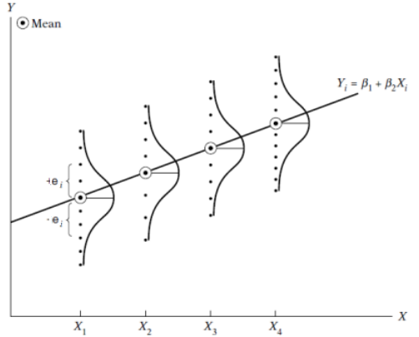
Regression Model Assumptions
Assumption 2
X values are independent of the error term. Values taken by the regressor X may be considered fixed in repeated trials / sample. The error in prediction of each trial is independent of the value of X.
Error term ui, represents the impact of the variables not considered for the model. Since the assumption that X predictors are independent of one another, it applies to even those variables not considered
Assumption 3
The mean value of disturbance ui is zero. Given the value of Xi, the means or expected value of the random disturbance E(ui | Xi) = 0 i.e. E(ui) = 0
Population of y corresponding to a given Xi is distributed around its mean value, implies no specification bias / error in the model indicating that the model is correctly specified.
Specification error results from leaving out important variables or choosing wrong functional form to express relationship between y and X

Slide 4
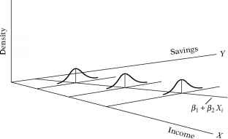
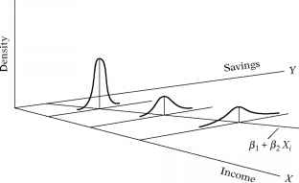
Regression Model Assumptions
Assumption 4
Homoscedasticity or Constant Variance of ui, the variance of the error / disturbance is the same regardless of the value of X
Var(ui) = E[ ui - E(ui | Xi)]^2 = E(ui^2 | Xi) because of assumption 3 (E(ui) = 0).
= E(ui^2) for a given Xi = constant variance (representation for homoscedasticity)
The likelihood that the y observations coming from the population with X = Xi would be closer to the population regression function than those coming from the populations corresponding to X = X2, X = X3 and so on. The reliability of predicted Y will fall
By invoking Assumption 4, we stress equal importance to all y values corresponding to different values of X
Heteroscedasticity
Homoscedasticity
Image source: https://www.rhayden.us/regression-models/the-nature-of-heteroscedasticity.html

Slide 5
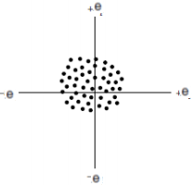
Regression Model Assumptions
Assumption 5
No autocorrelation between disturbances ui. Given any two X values, Xi and Xj (I <> j), the correlation between any to ui and uj is zero i.e. no serial or auto correlation
This assumption is justified when time is not an attribute i.e. the trials / records are not generated in any time-series fashion
Assumption 6
The number of observations n must be greater than the number of parameters to be estimated. In data science parlance, the depth should be much greater than breadth i.e. number of records much larger than the number of columns to avoid curse of dimensionality situation.
Assumption 7
The X should have variance. The values should not be constant. In Data Science parlance, X should have variance. Further the outliers should not exist

Slide 6
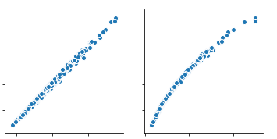
Regression Model Assumptions
Assumption 8
There no perfect collinearity between the predictor variables X
In case of perfect collinearity, the scatter plot will be line
Most often we come across less than perfect collinearity
Assumption 9
The model is correctly specified i.e. neither overfit or underfit
Assumption 10
The stochastic term ui is normally distributed. The error term ‘e’ follows the normal distribution with zero mean and (constant) variance
where the symbol ∼ means distributed as and N stands for the normal distribution, the terms in the parentheses representing the two parameters of the normal distribution, namely, the mean and the variance. If this assumption is violated, the statistical tests such as t, and F in regression may not be valid.
Note: All the assumptions pertain to population regression function only.

Slide 7
Significance of stochastic disturbance term
The disturbance term ui is a surrogate for the variables that are left out of the model but have a collective impact on the output y.
The reason why those variables were left out could be many
We may not fully understand how those variables impact the output (theoretically weak)
Lack of data for those variables. Some variables are not quantitative by nature and we may not have a way to capture such data for e.g personality of an individual that impacts his/her monthly expenses
Peripheral variables – Some variables have a weak influence on the target and their joint influence may be very weak. Such variables can be represented by the ui
Intrinsic randomness in the process. For e.g. personality of individuals may vary significantly even when the most of the measurable attributes are same
Principle of parsimony requires that we keep our models as simple as possible (Occam’s razor). If significant part of y’s behavior can be captured by a few variables, then why not keep it simple. Let the other variables collective effort be represented by the ui

Slide 8
Disturbance term expected value
Assumptions 3 (The mean value of disturbance ui is zero) ….. Why?
Let linear regression model be yi = β1 + β2X2i + β3X3i + ….+ βkXi + ui (a data point in K dimensions)
Assume E(Ui | X2i, X3i…..,Xki) = W (W is a constant , in standard model W = 0)
Conditional expectations of the equation for yi can be expressed as
E(yi | X2i, X3i,…..Xki) = β1 + β2X2i + β3X3i + ….+ βkXi + W
=> (β1 + W) + β2X2i + β3X3i + ….+ βkXi
=> α + β2X2i + β3X3i + ….+ βkXi where α = (β1 + W)
Given the training data, the Xs are treated as constant while the βs are the variables
If the assumption 3 is not fulfilled, we cannot solve the equation for β1!

Slide 9
Heteroscedasticity of disturbance
Homoscedasiticity or Constant Variance of ui, the variance of the error / disturbance is the same regardless of the value of X.
Violation of this assumption leads to Heteroscedasticity. There are several reasons for this –
As the processes mature and stabilize over a number of operations, the variability in the output falls. For e.g. a new coder may show more variance in coding productivity and an experienced one
As one input variable grows, the process outputs vary more for e.g. as monthly household income grows, there is more choice to spend on and hence the savings may fluctuate depending on the household preferences
Data collection techniques improve, the data collected first may show more variations than the data collected last
Outliers can lead to heteroscedasticity
Skewness in data can lead to heteroscedasticity. For e.g. few individuals with extremely high incomes will contribute most to the variations
The model specified may not be the correct one. We chose a simple linear model while the model should be relatively more complex

Slide 10
Heteroscedasticity of disturbance (Contd…)
Variance of ui, homoscedastic or heteroscedastic plays no part in the determination of the coefficients. Even with heteroscedasticity the coefficients will converge to the population value of the coefficients. Infact the distribution of the coefficients remains asymptotically normally distributed.
The problems is, the coefficients will have lot of variance and make the overall model less accurate. The OLS method does not take into account the heteroscedastic nature of certain attributes relative to others. It gives same weightage to all attributes. On the other hand GLS (Generalized Least Square) method takes into account such difference and gives lesser weight to attributes with more heteroscedasticity and in the process result in better models

Slide 11
Multi-Collinearity

Slide 12
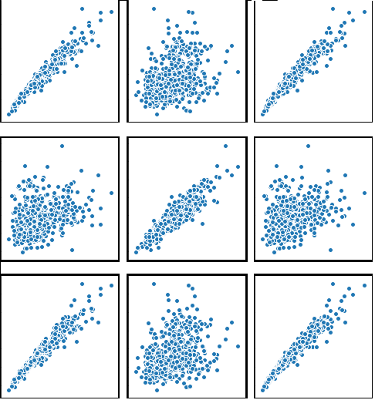
Multi Collinearity – What is it?
Multicollinearity is that situation where the independent variables in the linear model are not truly independent i.e. they are correlated. For e.g. in the Wisconsin Breast Cancer dataset the first three attributes “radius mean”, “perimeter mean” and “texture mean” is shown below. The first two are strongly correlated
Radius mean
Texture mean
Texture mean
Radius worst
Texture Worst
Perimeter Worst

Slide 13
Multi Collinearity – Types of multicollinearity
Structural multicollinearity: This type occurs when we create features from existing features and build a model using all of the features. For example, using “Radius” and “Area” as two variables. When features are generated, ensure the generated feature and the original features do not strongly correlate, if they do, you may want to drop the original feature as long as the generated feature contains all the information from the original
Data multicollinearity: This type of multicollinearity is an artifact of the data itself. The nature of the variables is such that they correlate. For e.g. in auto-mpg.csv, the columns “weight” and “horsepower” of a car will correlate positively. In case there are such correlating variables in the data, they may be combined into a composite variable using techniques such as PCA

Slide 14
Multi Collinearity
Assumptions 8 (There no perfect collinearity between the predictor variables X) – is technically known as the assumption of no collinearity or no multicollinearity when more than one variables is involved
Formally, no collinearity means there exists no two numbers λ2 and λ3 such that λ2x2 + λ3X3 = 0. If such a relationship exists, then X2 and X3 are said to be collinear or linearly dependent
On the other hand if the equation holds only when λ2 and λ3 = 0 , then the variables are non-collinear
In simple terms, multicollinearity is the situation when two or more variables used in a model, are related to each other i.e. change in values of one leads to change in values of other
The problem with having multicollinearity is in the inability to understand how one variable influences the target. There is no way to estimate separate influence of each variable on target. Thus no way to estimate the partial regression coefficients

Slide 15
Multi Collinearity (Contd…)
If multicollinearity is perfect, the regression coefficients of X variables are indeterminate and their standard errors are infinite
If multicollinearity is less than perfect, the regression coefficients, although determinate, posses large standard errors, which means the coefficients cannot be estimated with confidence
High degree of multicollinearity will not take away the property of being best unbiased linear estimators. It violates none of the regression assumptions. The only problem is that it will result in hard to determine coefficients with small standard errors
But the same problem occurs when we have too few observations or the independent variables have small variances

Slide 16
Multi Collinearity – What is the problem?
Independent variables should be independent of one another. Instead, if they correlate strongly, it can lead to sub-optimal model and mislead in terms of statistical results such as P values
The main objective of regression analysis is to express the relationship between each predictor variable and the dependent variable independently.
The regression coefficient is a measure of mean change in the dependent variable for each 1 unit change in an independent variable keeping all other independent variables constant. However, with collinear independent variables, it will not be possible to change one variable keeping others constant!
The coefficient estimates for an independent variable Vs the target variable can swing wildly based on inclusion or exclusion of other correlated independent variables are in the model. The coefficients become very sensitive to changes in the model structure
Multicollinearity reduces the precision of the estimate coefficients, which weakens the statistical power of your regression model. You might not be able to trust the p-values to identify independent variables that are statistically significant

Slide 17
Multi Collinearity – Testing for multicollinearity with Variation Inflation Factor (VIF)
The variance inflation factor (VIF) identifies correlation between independent variables and the strength of that correlation.
Statsmodel based linear models provide a VIF for each independent variable
VIFs start at 1 and have no upper limit.
A value of 1 indicates that there is no correlation between this independent variable and any others
VIFs between 1 and 5 suggest that there is a moderate correlation, but it is not severe enough to warrant corrective measures
VIFs greater than 5 represent critical levels of multicollinearity where the coefficients are poorly estimated, and the p-values are questionable.

Slide 18
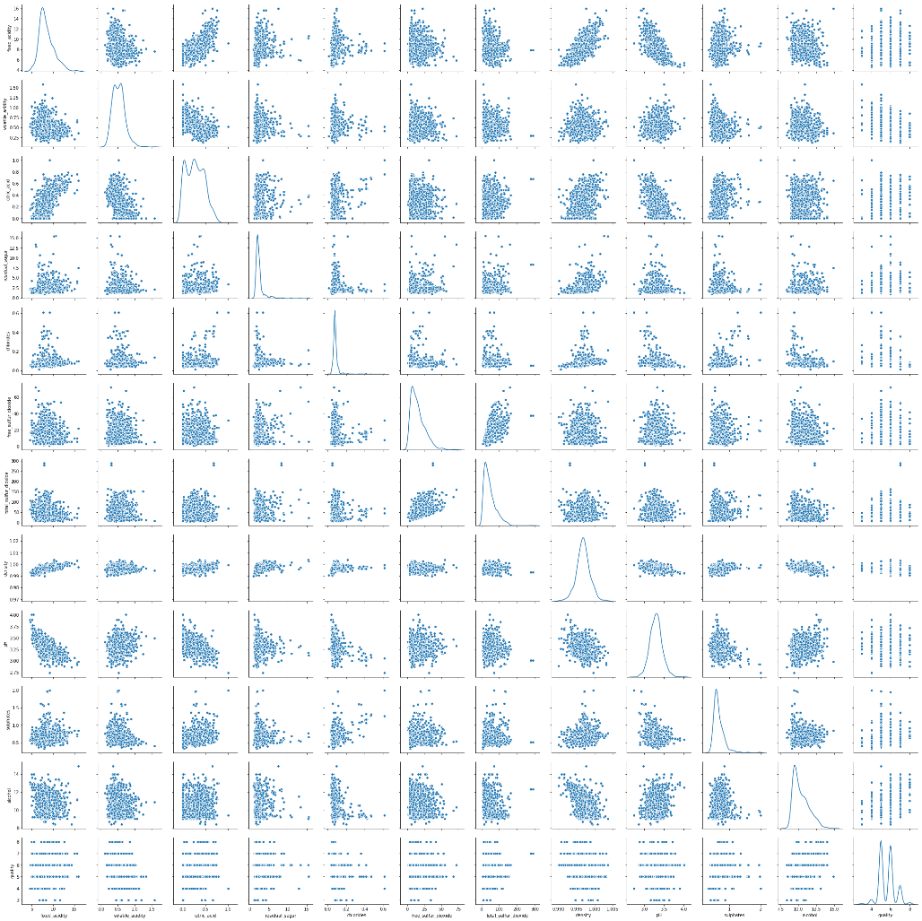
Testing for multicollinearity with Variation Inflation Factor (VIF)
Red wines dataset, correlation between features and VIF values
Most attributes have very high value of VIF
fixed_acidity ---> 80.0219390812402
volatile_acidity ---> 16.57719262878206
citric_acid ---> 9.774864397481704
residual_sugar ---> 4.906541592370461
chlorides ---> 6.529251770198401
free_sulfur_dioxide ---> 6.448644902127925
total_sulfur_dioxide ---> 6.877056111151861
density ---> 1445.240488945372
pH ---> 1037.4662099590764
sulphates ---> 20.65264657492166
alcohol ---> 121.46712238121306

